Slide 1
Proviso with Pseudowords: A Pilot Study
2020 Nov 20
Link: https://spellout.net/ibexexps/sherrychen/proviso2020_pilot2/experiment.html

Slide 2
Participants
42 participants recruited from MTurk
3 non-native speakers
Filtering based on the control item: Control.Presup > 60 (78%) AND Control.Ant < 10 (78%)
Remaining: 23
Super noisy!!!

Slide 3
Key Changes from Pilot 1 (Nov 13)
Added narrative: journalistic adventure to 5 planets
Added the Null Context condition
Changed “surprised” to “unexpected”
Changed the form of the context sentence for independent
Changed labels on the scale from numbers to texts

Slide 4
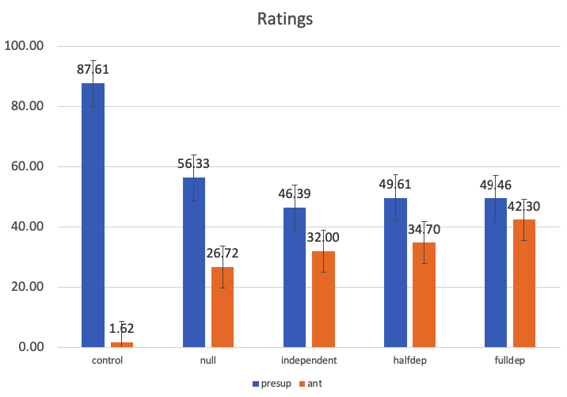

Ratings: Control
“John doesn’t have a dord” is close to 90, because it was a contradiction
“John is a glorp” is close to 0, because it was consistent with prior information

Slide 5

Ratings: Null
Null.Presup has the highest ratings of all critical presups, but not much higher
Null.Ant has the lowest ratings of all critical ants, but not much lower

Slide 6

Ratings: Independent
Independent.Presup is around 46, similar to its rating in Pilot 1 (around 44).
Unlike Pilot 1, however, it is a bit lower than the presup in halfdep & fulldep conditions!

Slide 7

Ratings: HalfDep & FullDep
HalfDep & FullDep
Presup: almost identical
Ant: similar, but fulldep.ant is a bit higher (like last time???)
But crucially, their presup conditions are NOT lower than independent.presup, unlike Pilot 1

Slide 8
Reflections: What could have caused the diff?
Could it be because we changed “surprised” to “unexpected”?
It probes the participant’s intuition more directly (“how surprised are you” vs. “how unexpected do you find the statement”)
Less negation: “not surprising” vs “not unexpected”
Why should there be this difference in the positive case tho……
The context sentence?
1: Some aliens have dords, but it doesn’t matter if they are glorps or not
2: Glorps or not, some aliens have dords
Could the former be more explicit than the latter (might matter cuz many participants are speed running through it…

Slide 9
Reflections: What could have caused the diff?
It’s a simple task & very easy to strategize. Could we be including too many items already, and by the time they see halfdep, they are already strategizing? (e.g. rate high for the 1st Q, but a bit lower for the 2nd Q)
In that sense, in pilot 1 the “independent” was one shot and one shot only; might have picked up more delicate differences
Vs. in pilot 2, especially if “null context” and “independent” have very similar intuitions, ppl may have generalized by the end of “independent” and start strategizing…
If this is the problem, how do we get around it?
Version 1: control, null context, halfdept
Version 2: control, independent, halfdept

